Slide 1
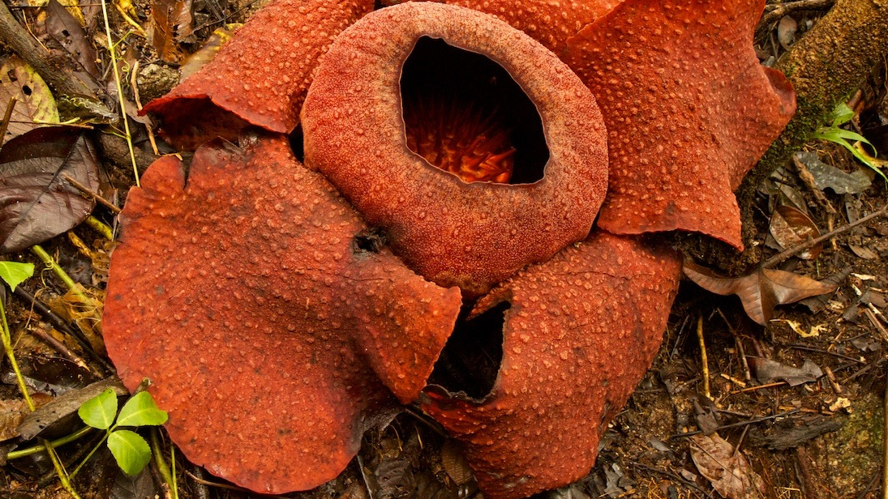
Phylogenomics of Rafflesiaceae
Liming Cai
Nov 12, 2020

Slide 2
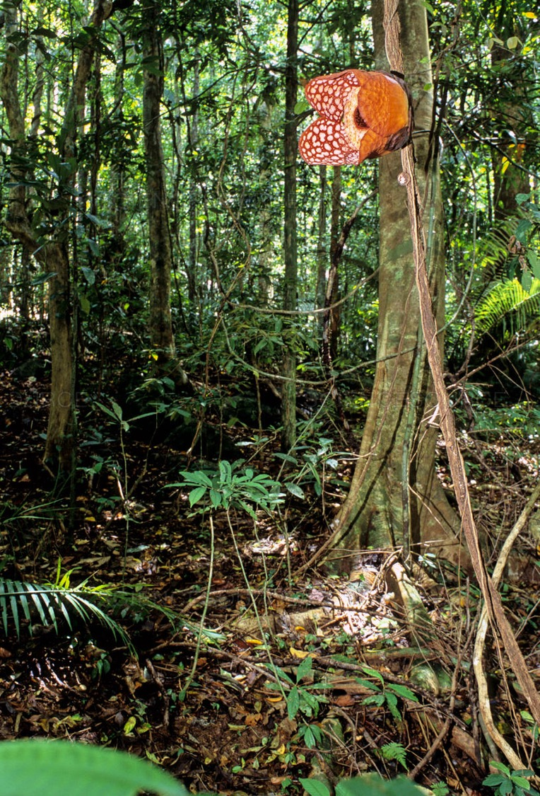
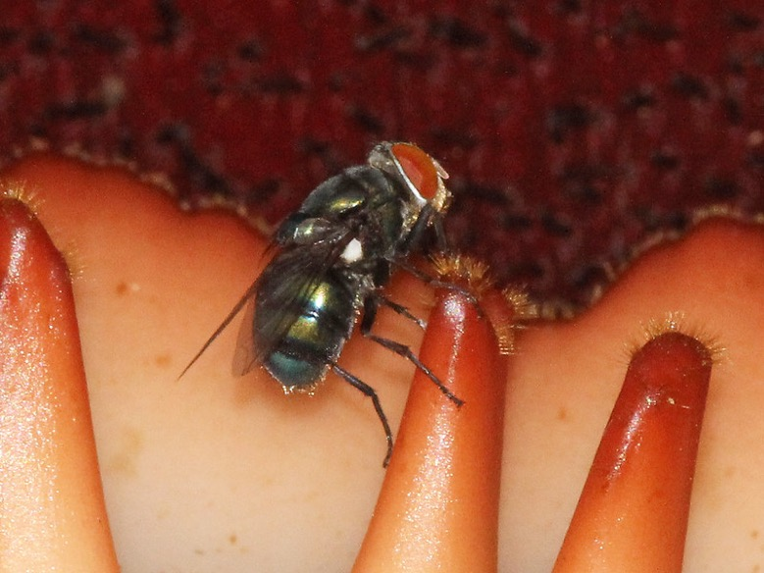
Rafflesiaceae
Largest flower and almost no vegetative organs
Deceptive pollination by carrion flies
3 genera; all specialized parasites of Tetrastigma (the grape family) in Southeast Asia
Rafflesia cantleyi

Slide 3
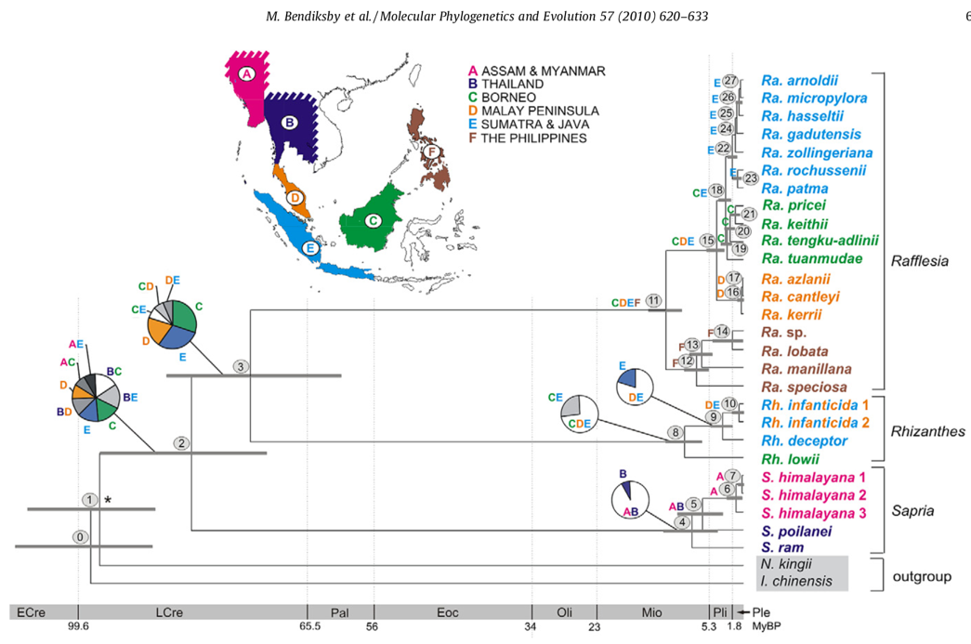
Biogeography of Rafflesiaceae

Slide 4
Phylogenomic data set
42 Malpighiales species primarily transcriptomes, but several genomes are included, too
2,141 orthogroups meet the following criteria
Contain at least one VGT gene copy from Rafflesiaceae
At least 10 (25% species completeness) ingroup species
Pruned to have one gene per species using Yang & Smith (2014)

Slide 5
Main problem
Horizontal gene transfer
Mutational noises, e.g., long branch attraction

Slide 6
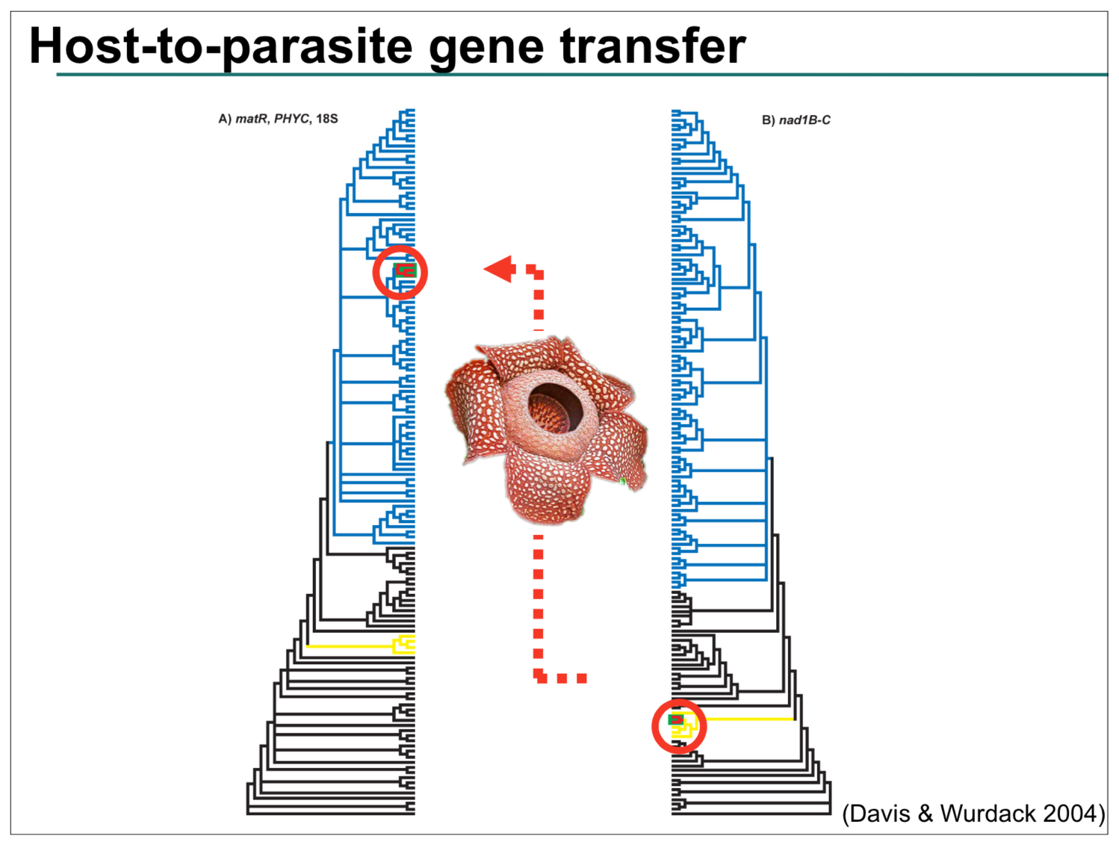

Slide 7
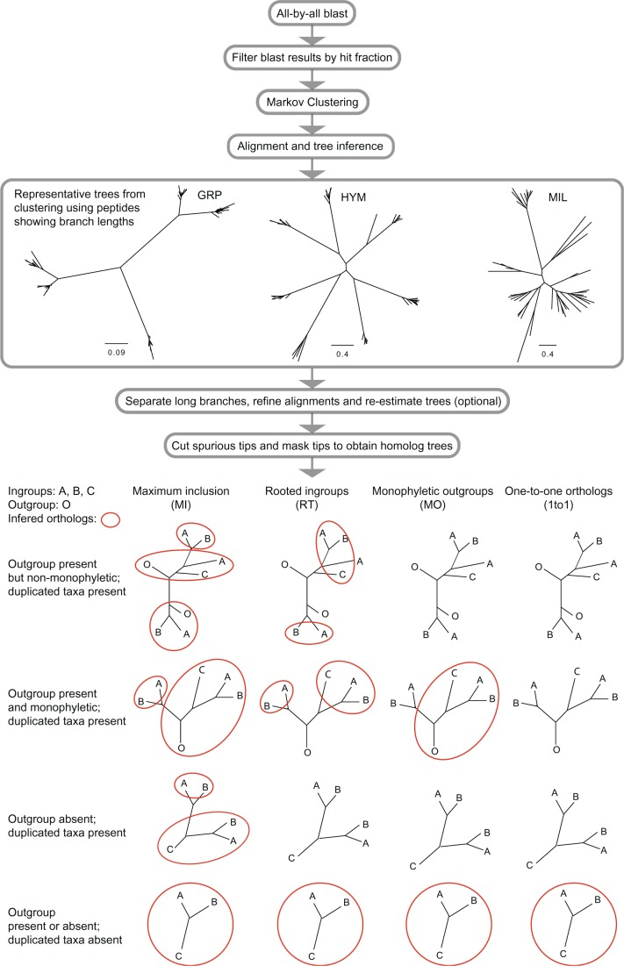
Removing HGT and getting single-copy nuclear genes

Slide 8
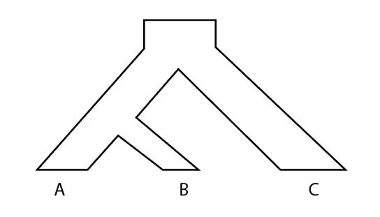
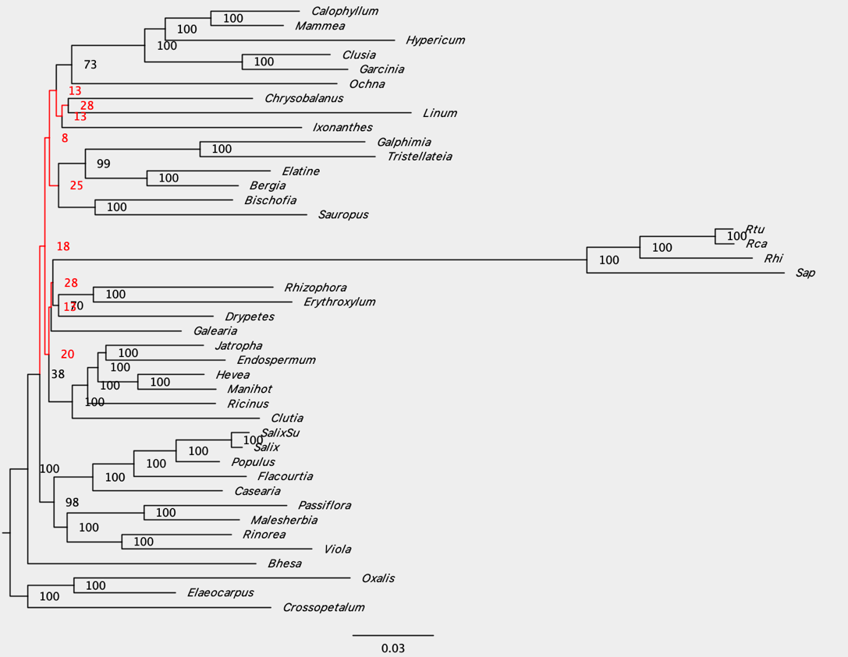
Mutational noises—gene tree discordance
Podostemum
topology1
95.8%
topology3
31.09%
a1
b1
c1
topology1
34.85%
Gene1
a2
c2
b2
a3
c3
b3
topology2
34.05%
Gene2
Gene3

Slide 9
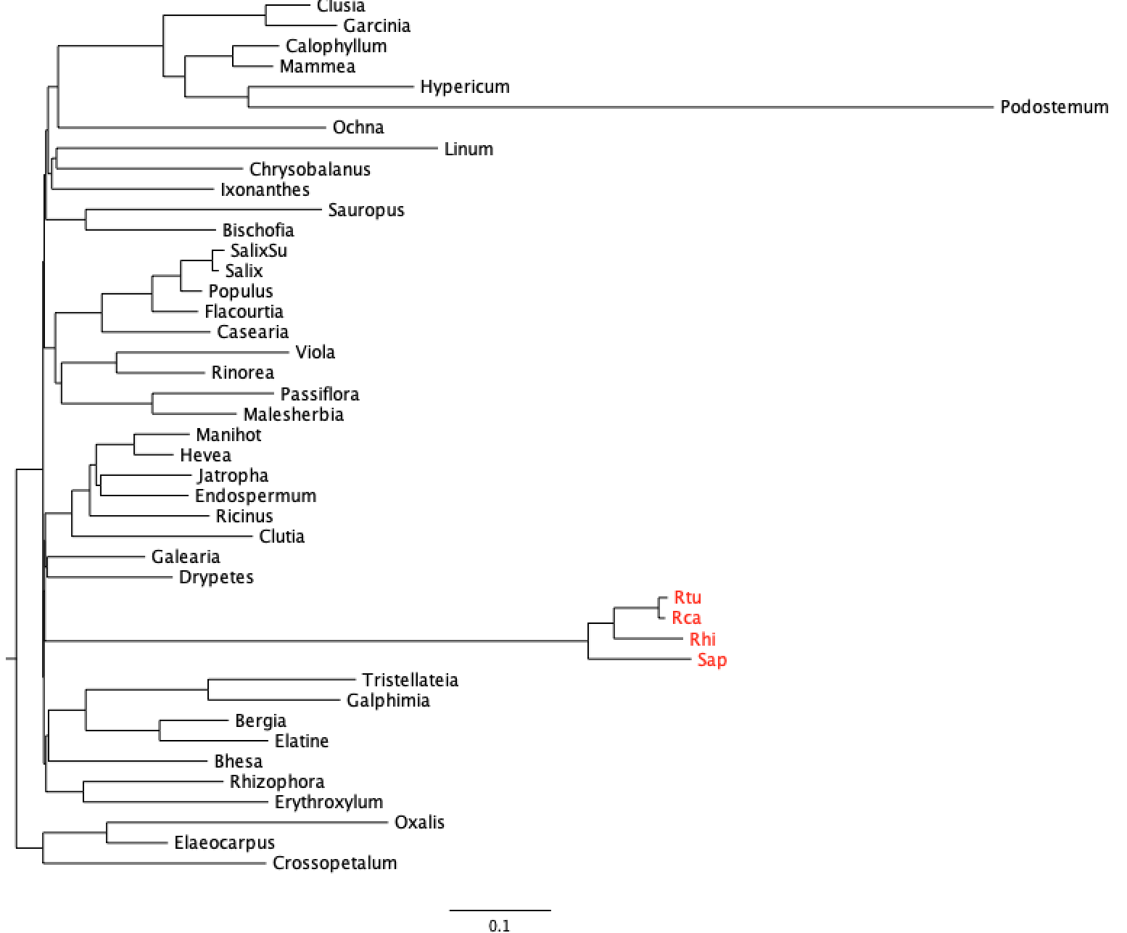
Mutation noises—long branch attraction

Slide 10
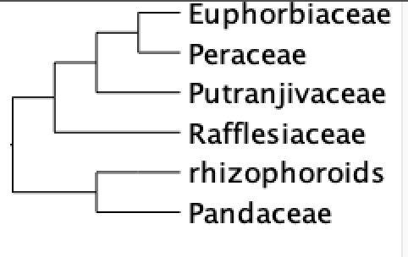
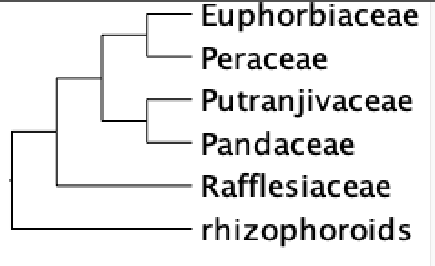
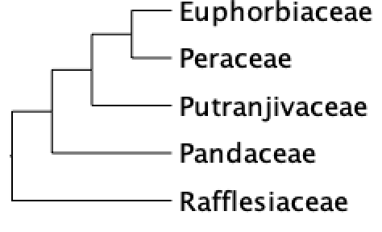
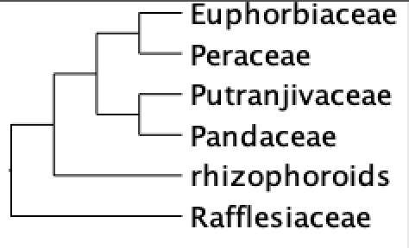
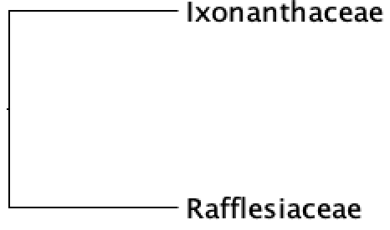
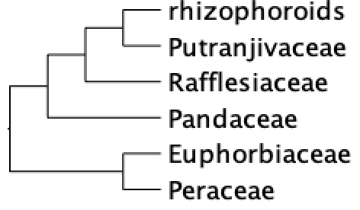
All-evidence approach to generate phylogenetic hypotheses
COALESCENT
ASTRAL
MPEST, ASTRAL, collapsing poorly
supported gene tree nodes
MPEST
MPEST, random
starting tree
CONCATENATION
RAxML, IQTREE, ExaML,
DNA and protein
RAxML, Dayhoff6 recode

Slide 11
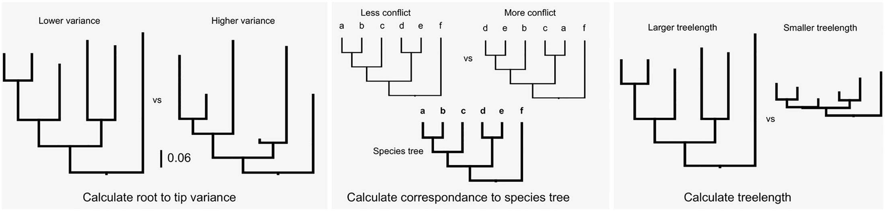

The gene shopping approach
Clock-like genes

Slide 12
Strong positive correlation, Pearson correlation 0.047
No correlation, Spearman correlation p value 0.76
Genes good for dating are not necessarily good for phylogeny reconstruction
Gene tree
concordance
Total tree length
Branch length variation

Slide 13
Gene subsampling
Missing data
34 species (80% completeness)
At least four out of the five focal group represented (Euphorbiaceae, Peraceae, Putranjivaveae, Pandaceae, rhizopphoroids)
Gene tree concordance
>0.2 species tree bipartition (top 70%)
647 genes meet these criteria for further investigation

Slide 14
Complex protein models
Bayesian Mixture Model for Across-Site Heterogeneities
CAT-GTR model in PhyloBayes
Empirical profile mixture models—an approximate variant of PhyloBayes’ CAT model
C10 to C60
Computationally intensive

Slide 15
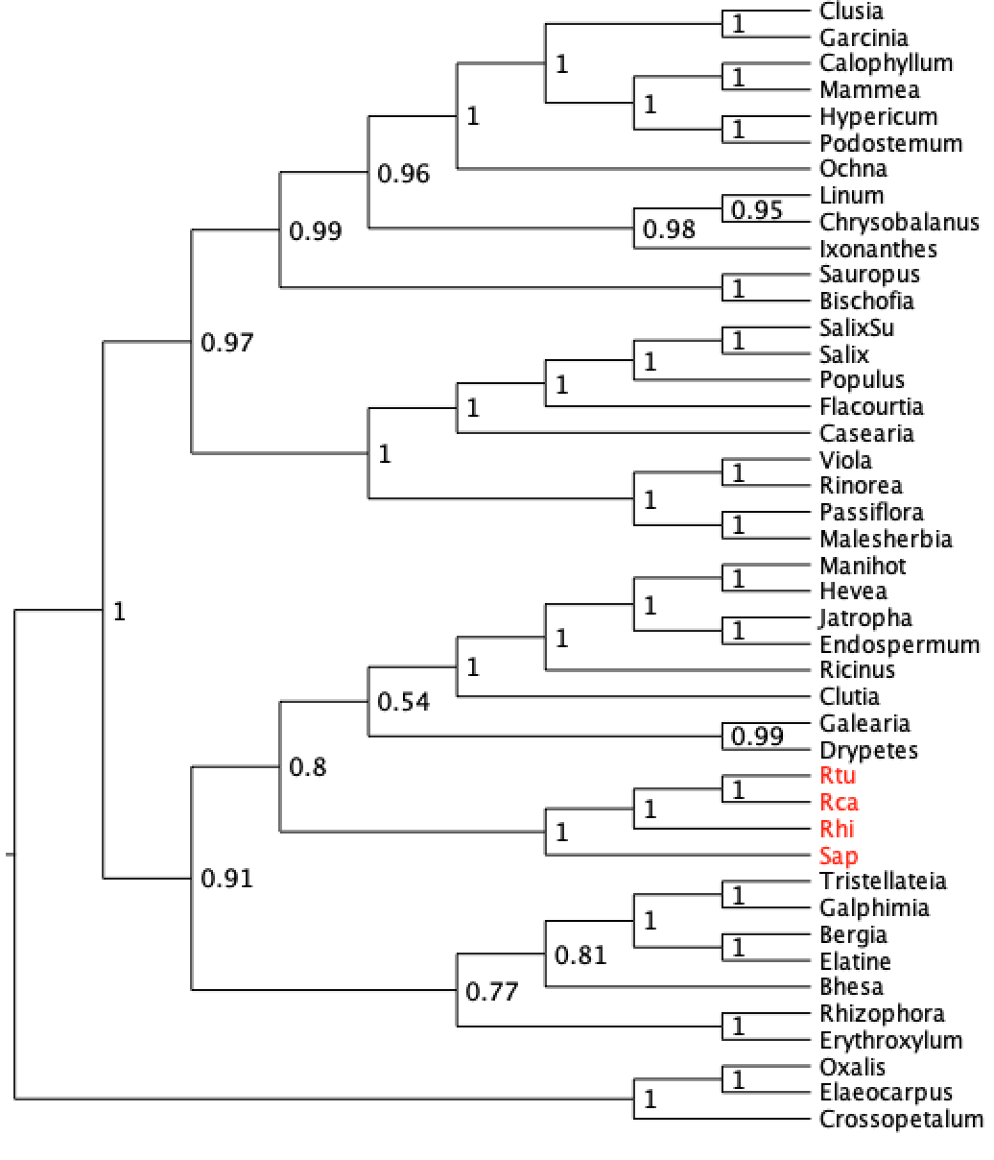
Phylobayes tree, 1000+ fold variation in branch length

Slide 16
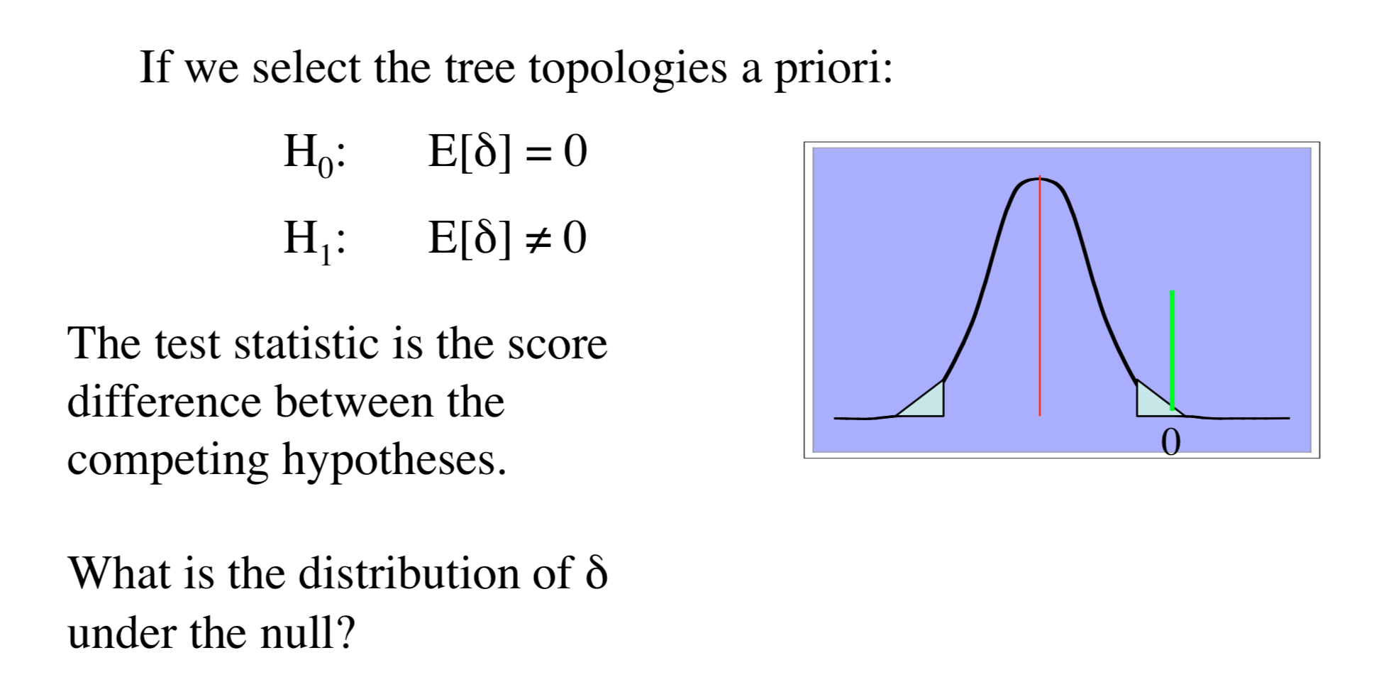
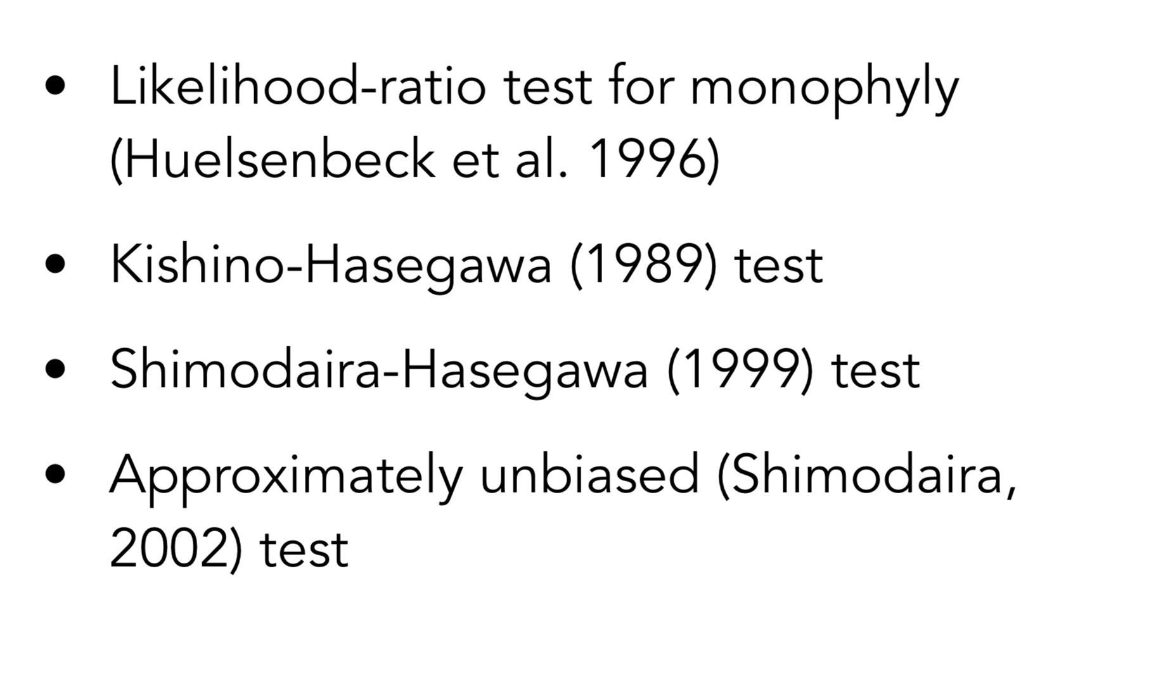
Phylogenetic hypothesis testing
Topology tests
DNA models
Protein models

Slide 17
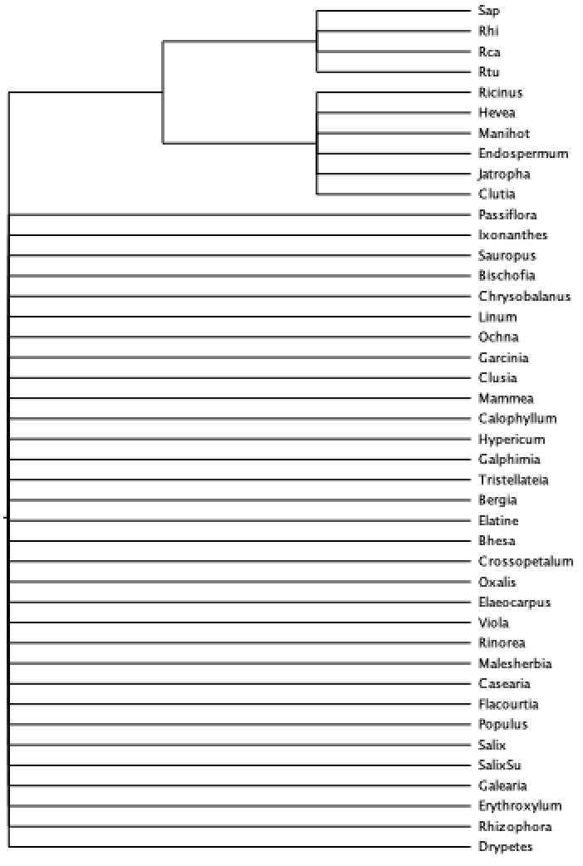
15 alternative topologies for testing
Only constrain the sister species of Rafflesiaceae
H1: Euphorbiaceae+Peraceae
H2: Putranjivaceae
H3: Pandaceae
…
H11: Euphorbiaceae+Peraceae +Pandaceae+ Putranjivaceae
…
H15: Euphorbiaceae (Davis et al. 2007)
H16: Ixonanthaceae (Concatenation)
H17: Passifloraceae (?)

Slide 18
DNA+GTR model
Tree logL deltaL bp-RELL p-KH p-SH p-WKH p-WSH c-ELW p-AU
-------------------------------------------------------------------------------------------
1 -11369480.03 2101.6 0 - 0 - 0 - 0 - 0 - 0 - 2.56e-08 -
2 -11367378.48 0 0.579 + 0.578 + 1 + 0.578 + 0.988 + 0.579 + 0.633 +
3 -11370264.65 2886.2 0 - 0 - 0 - 0 - 0 - 0 - 2.99e-37 -
4 -11367827 448.52 0.0082 - 0.0164 - 0.333 + 0.0164 - 0.124 + 0.00814 - 0.0177 -
5 -11369462.88 2084.4 0 - 0 - 0 - 0 - 0 - 0 - 0.00401 -
6 -11369995.89 2617.4 0 - 0 - 0 - 0 - 0 - 0 - 6.11e-26 -
7 -11371453.09 4074.6 0 - 0 - 0 - 0 - 0 - 0 - 3.55e-47 -
8 -11368138.79 760.31 0 - 0 - 0.0538 + 0 - 0 - 7.3e-264 - 2.89e-79 -
9 -11369979.92 2601.4 0 - 0 - 0 - 0 - 0 - 0 - 0.000176 -
10 -11368947.7 1569.2 0 - 0 - 5e-05 - 0 - 0 - 0 - 3.13e-160 -
11 -11370123.2 2744.7 0 - 0 - 0 - 0 - 0 - 0 - 1.19e-24 -
12 -11371072.51 3694 0 - 0 - 0 - 0 - 0 - 0 - 3.13e-06 -
13 -11370239.22 2860.7 0 - 0 - 0 - 0 - 0 - 0 - 1.08e-53 -
14 -11370958.14 3579.7 0 - 0 - 0 - 0 - 0 - 0 - 1.88e-37 -
15 -11373853.04 6474.6 0 - 0 - 0 - 0 - 0 - 0 - 7.38e-06 -
16 -11367448.37 69.888 0.413 + 0.422 + 0.802 + 0.422 + 0.799 + 0.413 + 0.422 +
17 -11392307.25 24929 0 - 0 - 0 - 0 - 0 - 0 - 5.91e-06 -
Putranjivaceae
(not supported by any methods)
Ixonanthaceae
(supported by concatenation)

Slide 19
Protein+C30 model
Tree logL deltaL bp-RELL p-KH p-SH p-WKH p-WSH c-ELW p-AU
-------------------------------------------------------------------------------------------
1 -4052889.881 41.954 0 - 0 - 0.665 + 0 - 0.0006 - 1.85e-05 - 8.38e-07 -
2 -4052910.671 62.744 0 - 0.0002 - 0.49 + 0.0002 - 0.0006 - 6.41e-10 - 2.49e-06 -
3 -4052888.534 40.607 0.0008 - 0.0018 - 0.674 + 0.0018 - 0.0138 - 0.000791 - 0.00323 -
4 -4052921.387 73.46 0.0004 - 0.0018 - 0.403 + 0.0018 - 0.0108 - 0.000402 - 0.000139 -
5 -4052889.881 41.954 0 - 0 - 0.665 + 0 - 0.0008 - 1.8e-05 - 4.08e-06 -
6 -4052909.746 61.819 0.0108 - 0.0672 + 0.483 + 0.0672 + 0.403 + 0.011 - 0.0905 +
7 -4052993.236 145.31 0 - 0 - 0.18 + 0 - 0 - 1.36e-06 - 2.45e-07 -
8 -4052886.826 38.899 0.0004 - 0.0004 - 0.694 + 0.0004 - 0.0024 - 0.000537 - 3.66e-05 -
9 -4052914.679 66.752 0.0006 - 0.055 + 0.459 + 0.038 - 0.249 + 0.000875 - 0.00574 -
10 -4052953.749 105.82 0 - 0.0004 - 0.277 + 0.0004 - 0.0036 - 1.36e-12 - 0.000137 -
11 -4052847.927 0 0.87 + 1 + 1 + 0.896 + 1 + 0.87 + 0.949 +
12 -4052925.912 77.985 0.0006 - 0.0354 - 0.397 + 0.0064 - 0.0422 - 0.000464 - 0.00453 -
13 -4052928.994 81.067 0 - 0.028 - 0.386 + 0.0104 - 0.0718 + 9.65e-05 - 0.000561 -
14 -4052901.2 53.273 0.0966 + 0.104 + 0.546 + 0.104 + 0.494 + 0.0961 + 0.16 +
15 -4053984.519 1136.6 0 - 0 - 0 - 0 - 0 - 0 - 2.24e-05 -
16 -4052892.585 44.658 0.0198 - 0.0222 - 0.634 + 0.0222 - 0.124 + 0.0196 - 0.0247 -
17 -4059847.729 6999.8 0 - 0 - 0 - 0 - 0 - 0 - 1.73e-72 -
Euphorbiaceae+Peraceae+Pandaceae
(not supported by any methods)
Euphorbiaceae+Peraceae+
Pandaceae+Putranjivaceae
(coalescent methods, PhyloBayes)
Euphorbiaceae+Peraceae+
Pandaceae+Putranjivaceae+rhizophoroids
(some coalescent methods)

Slide 20
Gene-by-gene topology test
Constrained search for individual gene
Examine likelihood
AU test

Slide 21
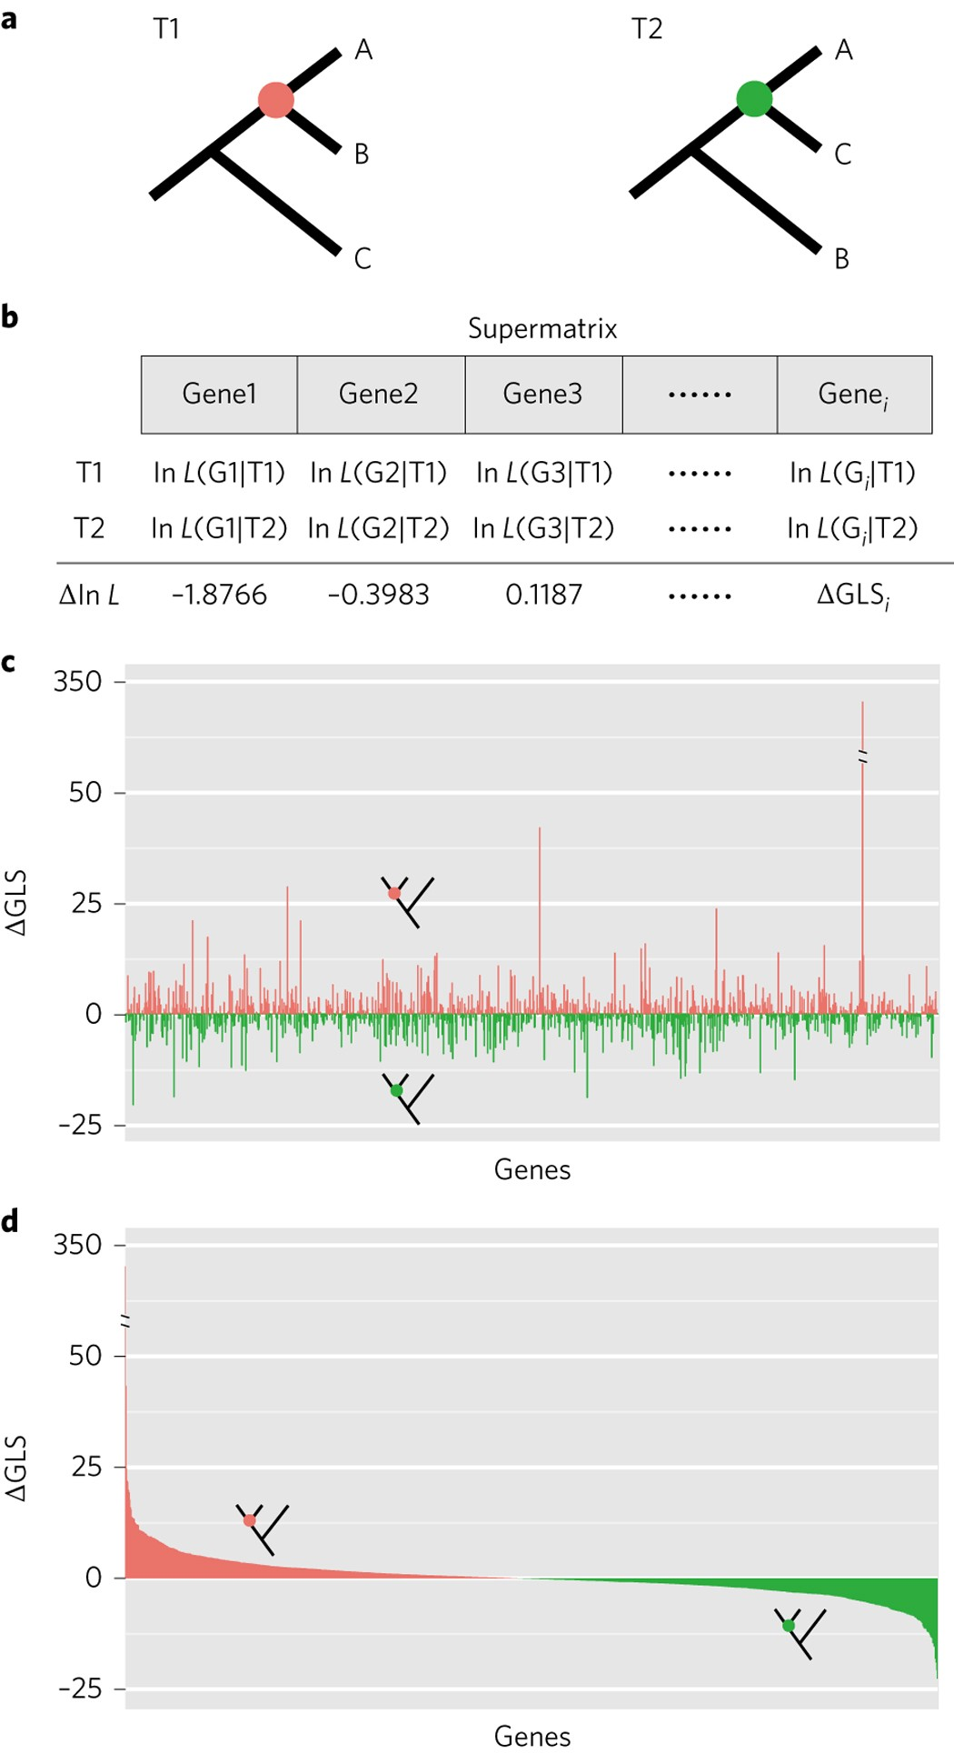
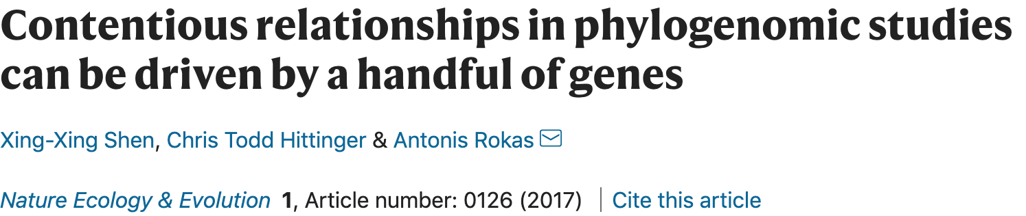
The likelihood ratio approach—a quick look at gene-wise signals

Slide 22
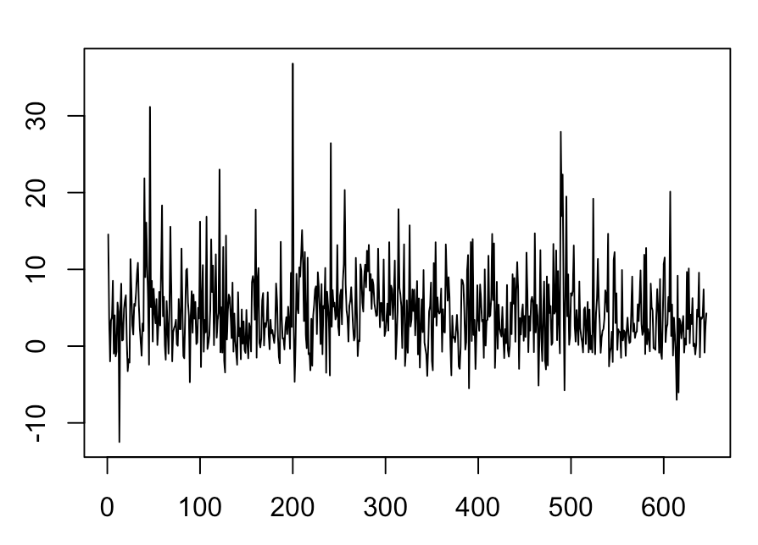
Comparing competing hypotheses using likelihood ratio test for each gene
H2 (Pandaceae) vs H15 (Euphorbiaceae)
⊿Likelihood
Gene

Slide 23
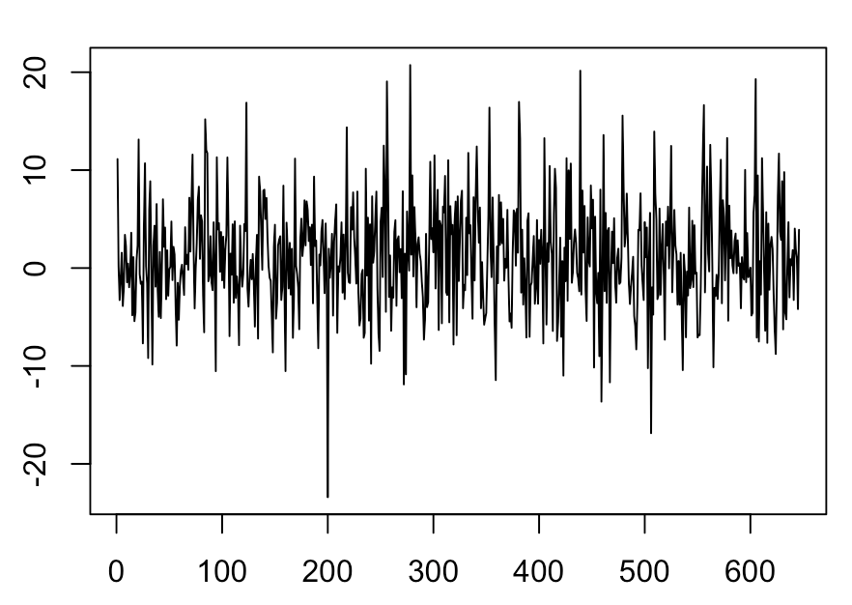
Comparing competing hypotheses using likelihood ratio test for each gene
H2 (Pandaceae) vs H16 (Ixonanthaceae)
⊿Likelihood
Gene

Slide 24
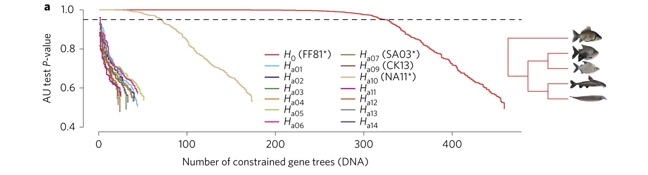
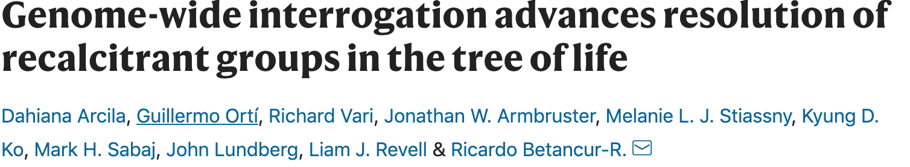
Gene-by-gene AU test (genome-wise interrogation, Arcila et al, 2017)

Slide 25
Focal hypotheses
All hypotheses
H2: Putranjivaceae
H2: Pytranjivaceae
H11 and H14
H16: Ixonanthaceae

